Slide 1
MALCOM Machine Learning for Communication Systems Lecture 7 Large-Scale Machine Learning & Optimization Photios Stavrou (Slides are courtesy of Marios Kountouris) Spring 2024

Slide 2
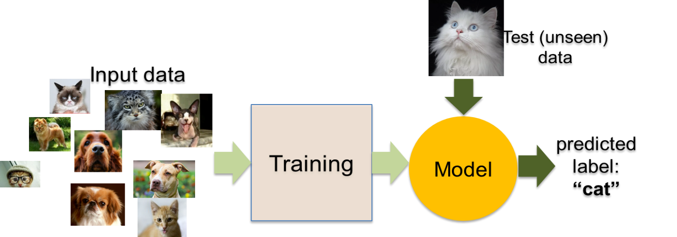

“Standard” ML Pipeline
Feature and Model Selection
Training burden
Training on ImageNet takes
10+ days (Oct. 2017)
0.5 hour (TPU Pods) – 2018
nowdays 2.5 mins on Alibaba Cloud
Very large neural nets can take many hours or weeks to train (2-3 years ago)
Check: DAWNBench https://dawn.cs.stanford.edu/benchmark/
Data Scalability
Datasets: TBs or PBs of raw data
Worldwide LHC computing grid can generate 15 PB of data/month
Size of sequencing data generated on human genomes may reach 250 PBs in a few years
Distributed computing to the rescue
Notes:
Ajouter une photo d’un vieux telegraphe, puis un mobile satellitte ancienne generation…can someone find an even older wireless communication system (smoke)

Slide 3




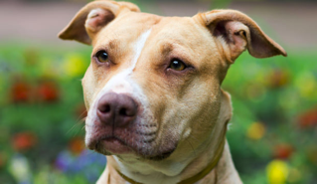


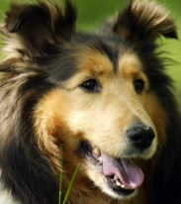

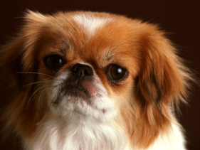
Feature Selection
Feature space
Pointy Ears
Size
Simplification of models
Improves Accuracy
Reduces Training Time
Goal: use “informative” features

Slide 4
Predictor Selection (hypothesis class)
Goal: pick a predictor that
(i) is expressive (ii) is easy to train (iii) does not overfit

Slide 5
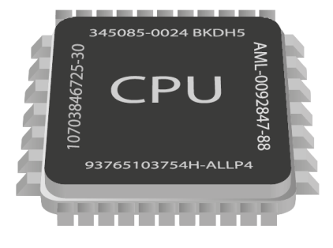
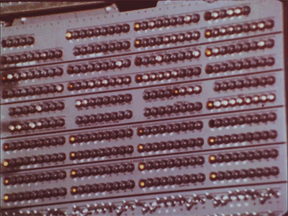
Statistical Learning
Goal: Train a model to minimize training (and testing) error
Predictive model
(classifier)
Ear Length
Snout Length

Slide 6
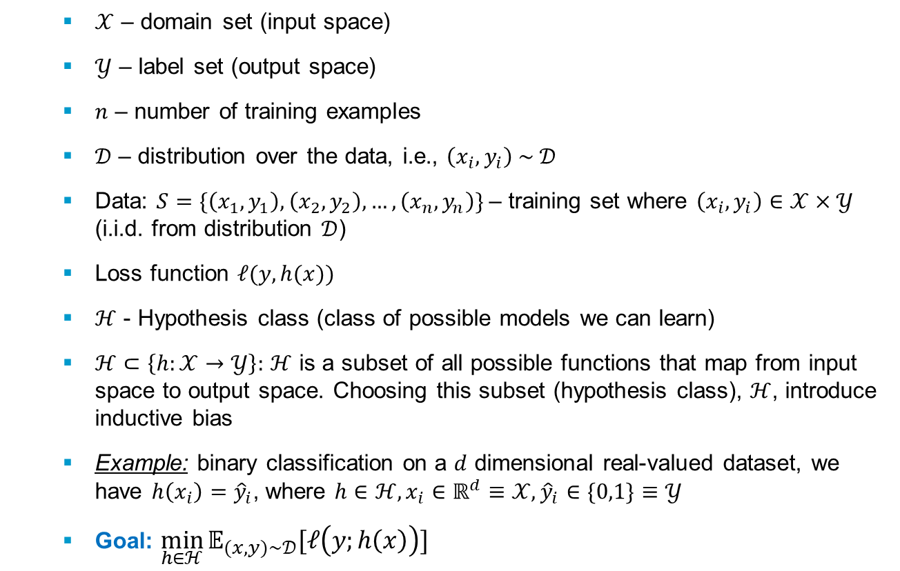
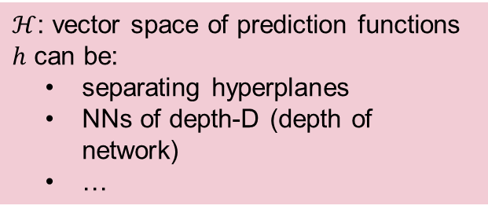
Statistical Learning Setting
$𝒳$ – domain set (input space)
$𝒴$ – label set (output space)
$n$ – number of training examples
$𝒟$ – distribution over the data, i.e., $\left(x_{i},y_{i}\right) \sim 𝒟$
Data: $S=\{\left(x_{1},y_{1}\right),\left(x_{2},y_{2}\right),…,\left(x_{n},y_{n}\right)\}$– training set where $\left(x_{i},y_{i}\right)∈𝒳×𝒴$ (i.i.d. from distribution $𝒟$)
Loss function $ℓ(y,h(x))$
$ℋ$ - Hypothesis class (class of possible models we can learn)
$ℋ⊂\left\{h:𝒳→𝒴\right\}:$ $ℋ$ is a subset of all possible functions that map from input space to output space. Choosing this subset (hypothesis class), $ℋ$, introduce inductive bias
Example: binary classification on a $d$ dimensional real-valued dataset, we have $h\left(x_{i}\right)={\hat{y}}_{i}$, where $h∈ℋ,x_{i}∈ℝ^{d}≡𝒳,{\hat{y}}_{i}∈\{0,1\}≡𝒴$
Goal: $\min_{h∈ℋ}{𝔼_{(x,y)\sim 𝒟}[ℓ\left(y;h\left(x\right)\right)]}$
$ℋ$: vector space of prediction functions
$h$ can be:
separating hyperplanes
NNs of depth-D (depth of network)
…

Slide 7
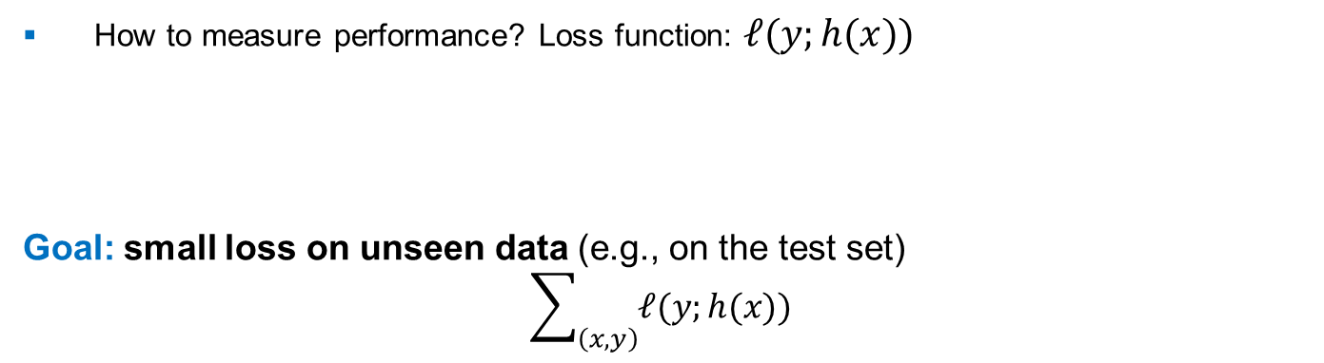
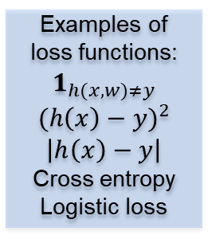
Goal of Training
Train a model: prediction function $h$ that performs well on unseen data.
Our trained predictor
Examples of loss functions:
$$1_{h(x,w)≠y}$$
$${(h\left(x\right)−y)}^{2}$$
$$\left|h\left(x\right)−y\right|$$
Cross entropy
Logistic loss
How to measure performance? Loss function: $ℓ(y;h(x))$
Goal: small loss on unseen data (e.g., on the test set)
$$\sum_{\left(x,y\right)}{ℓ(y;h(x)) }$$
Measures disagreement between predicted and true label
$$unseen$$
$$example$$
But, we haven’t seen… unseen examples
ut, we haven’t seen… unseen exampls
Notes:
Ajouter une photo d’un vieux telegraphe, puis un mobile satellitte ancienne generation…can someone find an even older wireless communication system (smoke)

Slide 8
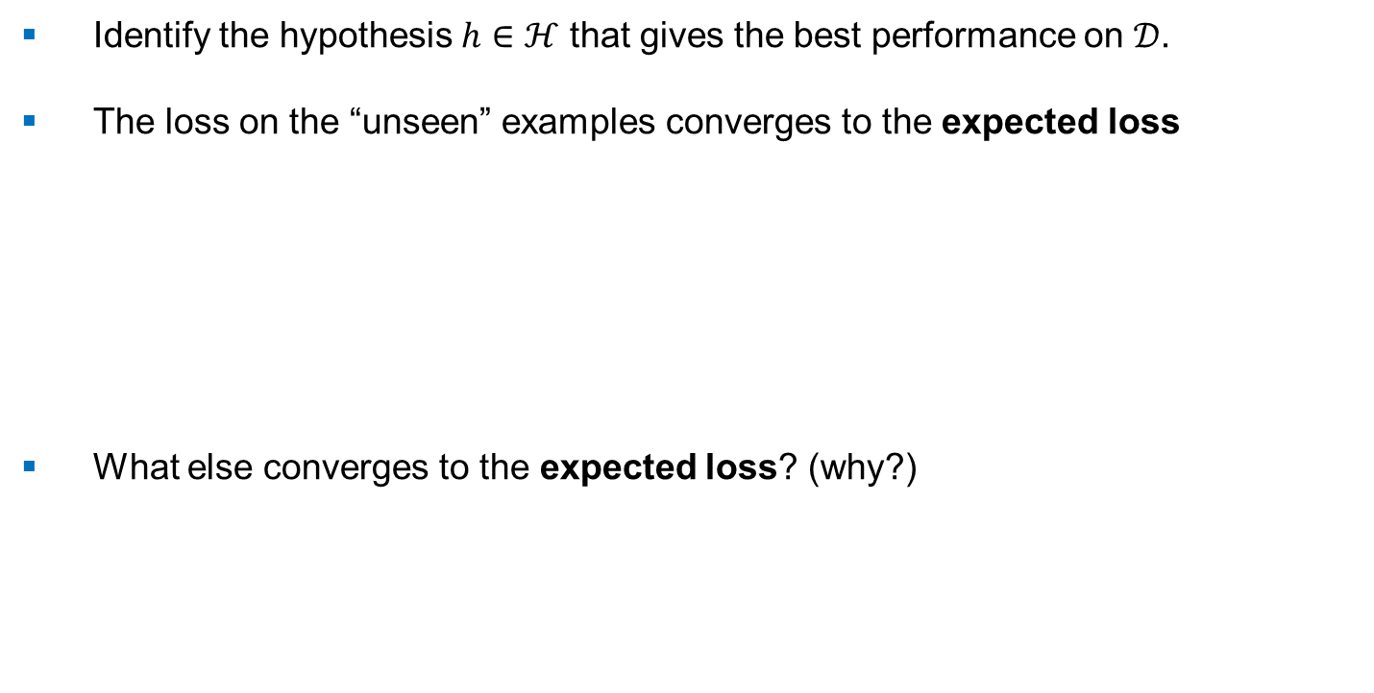
Goal of Training
Identify the hypothesis $h∈ℋ$ that gives the best performance on $𝒟$.
The loss on the “unseen” examples converges to the expected loss
What else converges to the expected loss? (why?)
$$\sum_{\left(x,y\right)\sim 𝒟}{ℓ(y;h(x)) }$$
$${R(h)≡𝔼}_{(x,y)\sim 𝒟}[ℓ\left(y;h\left(x\right)\right)]$$
Expected (True) Risk
Testing cost
$${\hat{R}}_{S}(h)≡\frac{1}{n}\sum_{i=1}^{n}{ℓ(y_{i};h(x_{i}))}$$
Empirical Risk
Training cost

Slide 9
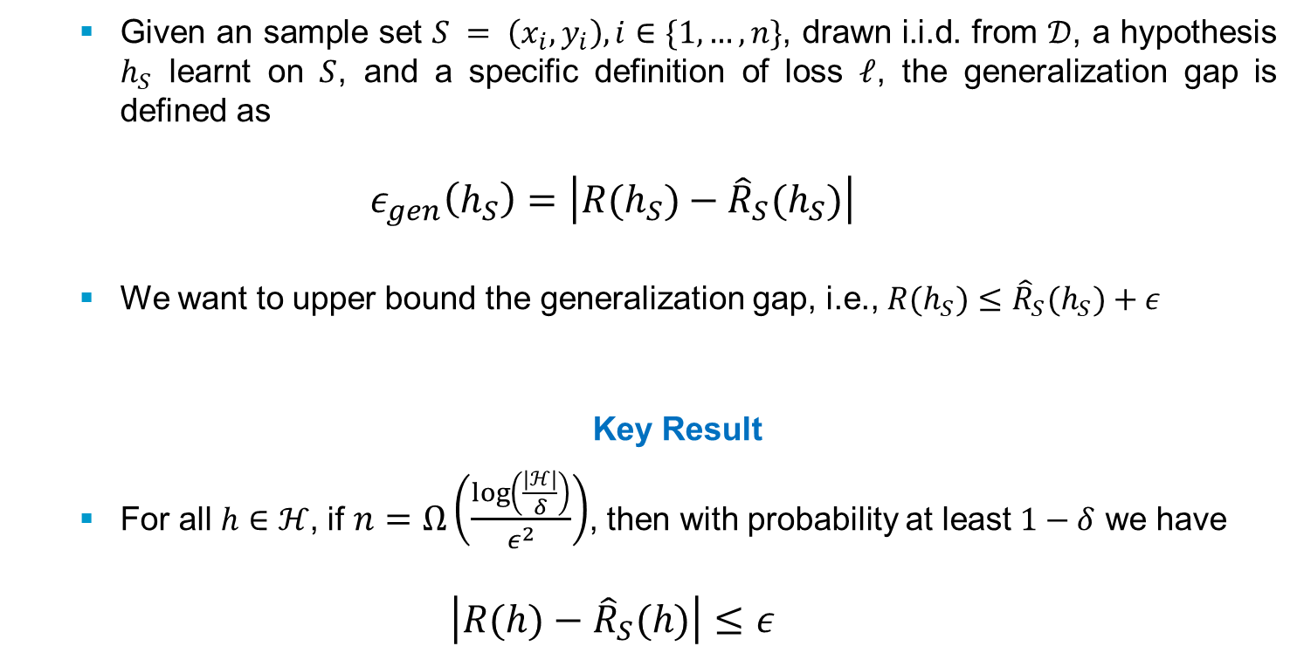
Generalization Gap
Given an sample set $S = \left(x_{i},y_{i}\right),i∈\{1,…,n\}$, drawn i.i.d. from $𝒟$, a hypothesis $h_{S}$ learnt on $S$, and a specific definition of loss $ℓ$, the generalization gap is defined as
$$ε_{gen}\left(h_{S}\right)=\left|R(h_{S})−{\hat{R}}_{S}(h_{S})\right|$$
We want to upper bound the generalization gap, i.e., $R(h_{S})≤{\hat{R}}_{S}(h_{S})+ε$
Key Result
For all $h∈ℋ$, if $n=Ω\left(\frac{\log\left(\frac{\left|ℋ\right|}{δ}\right)}{ε^{2}}\right)$, then with probability at least $1−δ$ we have
$$\left|R(h)−{\hat{R}}_{S}(h)\right|≤ε$$

Slide 10
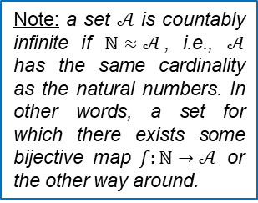
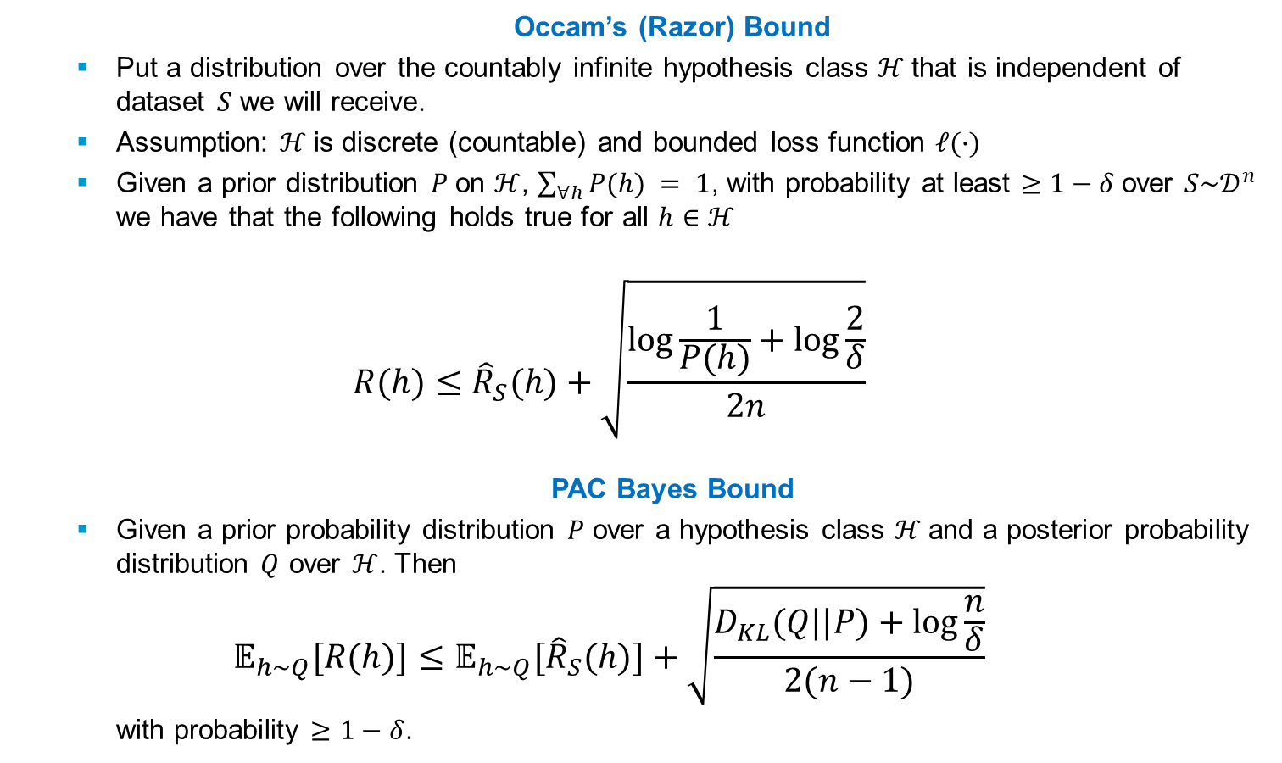
Generalization Gap (cont’d)
Occam’s (Razor) Bound
Put a distribution over the countably infinite hypothesis class $ℋ$that is independent of dataset $S$ we will receive.
Assumption: $ℋ$is discrete (countable) and bounded loss function $ℓ(∙)$
Given a prior distribution $P$on $ℋ$, $\sum_{∀h}{P(h)} = 1$, with probability at least $≥1−δ$over $S\sim 𝒟^{n}$ we have that the following holds true for all $h∈ℋ$
$$R(h)≤{\hat{R}}_{S}(h)+\sqrt{\frac{\log{\frac{1}{P(h)}}+\log{\frac{2}{δ}}}{2n}}$$
PAC Bayes Bound
Given a prior probability distribution $P$ over a hypothesis class $ℋ$and a posterior probability distribution $Q$ over $ℋ$. Then
$$𝔼_{h\sim Q}[R(h)]≤{𝔼_{h\sim Q}[\hat{R}}_{S}(h)]+\sqrt{\frac{D_{KL}(Q||P)+\log{\frac{n}{δ}}}{2(n−1)}}$$
with probability $≥1−δ$.
Note: a set $𝒜$ is countably infinite if $ℕ≈𝒜$, i.e., $𝒜$ has the same cardinality as the natural numbers. In other words, a set for which there exists some bijective map $f:ℕ→𝒜$ or the other way around.

Slide 11
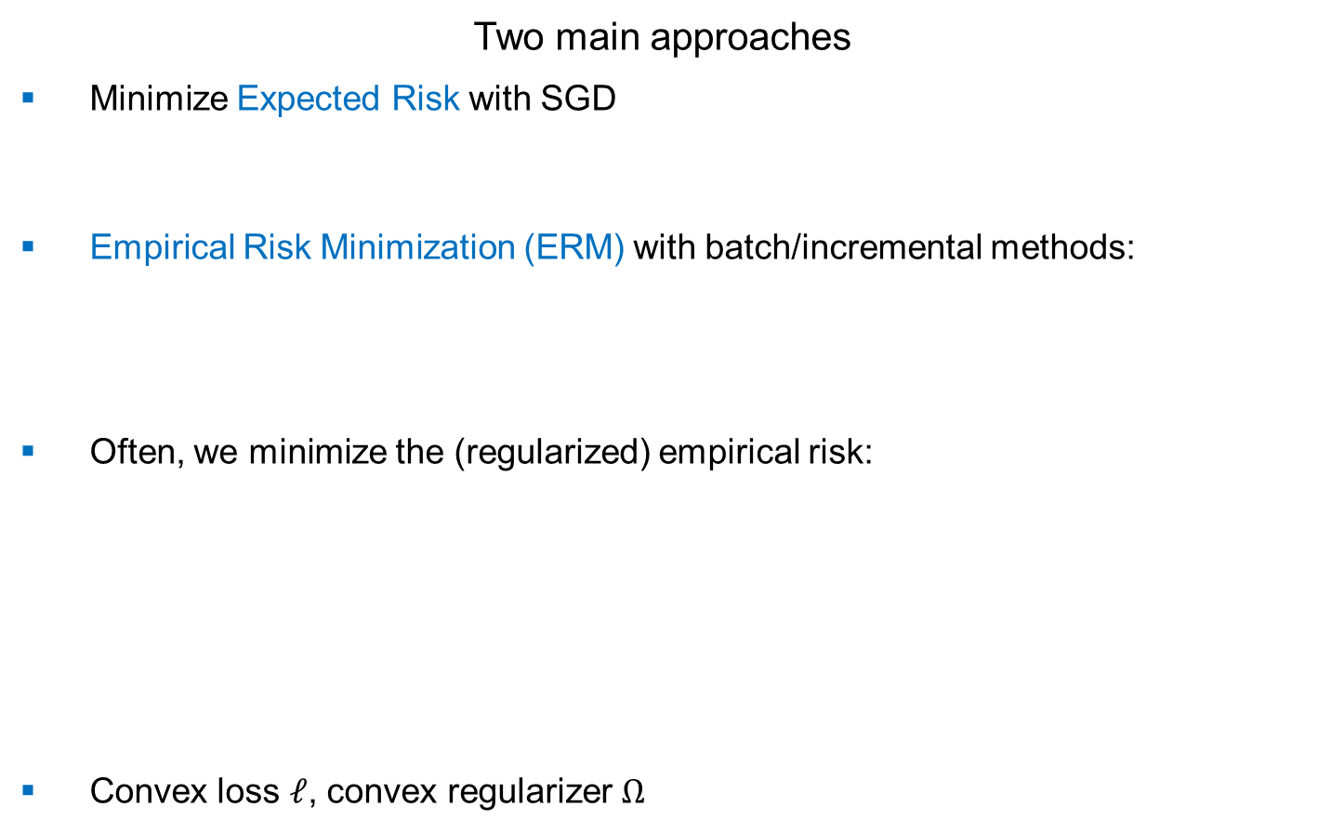
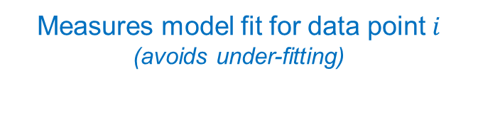
Large-Scale Learning
Two main approaches
Minimize Expected Risk with SGD
Empirical Risk Minimization (ERM) with batch/incremental methods:
Often, we minimize the (regularized) empirical risk:
Convex loss $ℓ$, convex regularizer $Ω$
$$\min_{h∈ℝ^{d}}{𝔼_{(x,y)\sim 𝒟}[ℓ\left(y;h\left(x\right)\right)]}$$
$$\min_{h∈ℝ^{d}}{\frac{1}{n}\sum_{i=1}^{n}{ℓ(y_{i};h(x_{i}))}}$$
$$\min_{h∈ℝ^{d}}{\frac{1}{n}\sum_{i=1}^{n}{ℓ(y_{i};h(x_{i}))} + Ω(h)}$$
Measures model fit for data point $i$
(avoids under-fitting)
Measures model “complexity”
(avoids over-fitting)

Slide 12
Large-Scale Learning
Two main approaches
Minimize Expected Risk with SGD
Empirical Risk Minimization (ERM) with batch/incremental methods:
Which one is better?
$$\min_{h∈ℝ^{d}}\left\{R(h)≔𝔼_{(x,y)\sim 𝒟}[ℓ\left(y;h\left(x\right)\right)]\right\}$$
$$\min_{h∈ℝ^{d}}\left\{\hat{R}(h)≔\frac{1}{n}\sum_{i=1}^{n}{ℓ(y_{i};h(x_{i}))}\right\} s.t. Ω(h)≤D$$
Lagrange duality

Slide 13
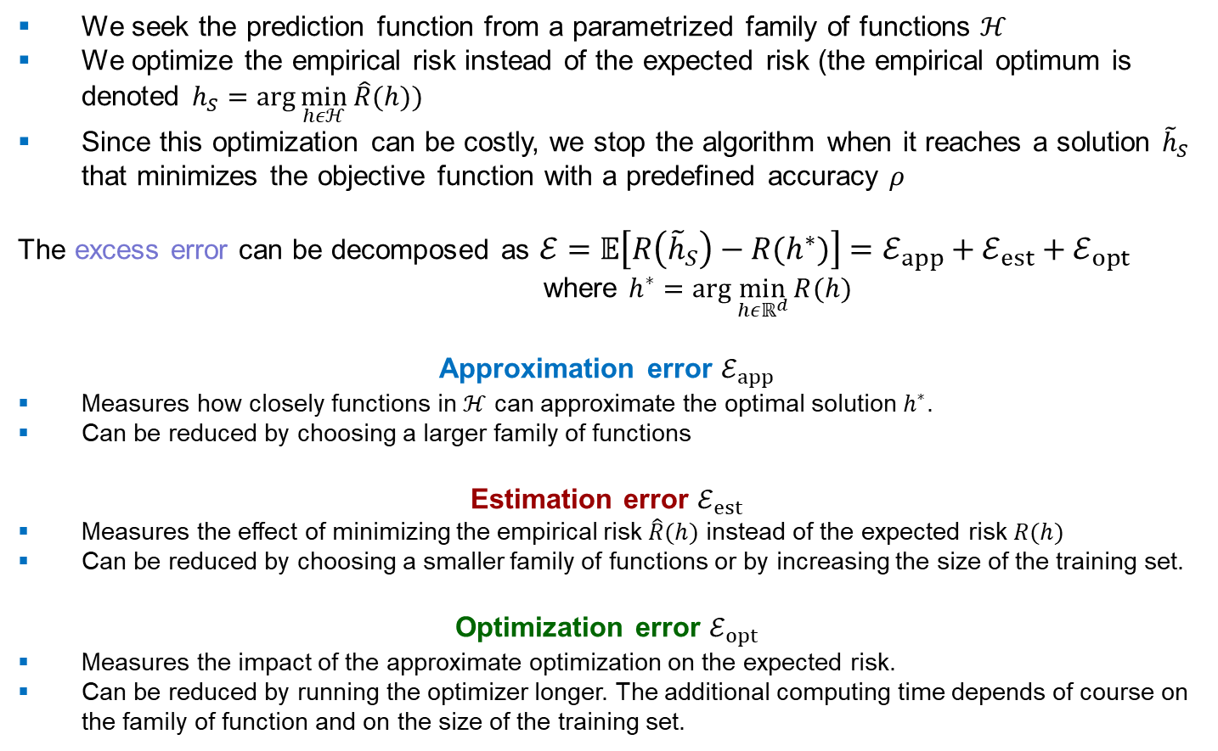
Large-Scale Learning Tradeoffs
We seek the prediction function from a parametrized family of functions $ℋ$
We optimize the empirical risk instead of the expected risk (the empirical optimum is denoted $h_{S}=arg\min_{hεℋ}{\hat{R}(h)})$
Since this optimization can be costly, we stop the algorithm when it reaches a solution ${\tilde{h}}_{S}$ that minimizes the objective function with a predefined accuracy $ρ$
The excess error can be decomposed as $ℰ=𝔼\left[R\left({\tilde{h}}_{S}\right)−R(h^{∗})\right]=ℰ_{app}+ℰ_{est}+ℰ_{opt}$
where $h^{∗}=arg\min_{hεℝ^{d}}{R(h)}$
Approximation error $ℰ_{app}$
Measures how closely functions in $ℋ$ can approximate the optimal solution $h^{∗}$.
Can be reduced by choosing a larger family of functions
Estimation error $ℰ_{est}$
Measures the effect of minimizing the empirical risk $\hat{R}(h)$ instead of the expected risk $R(h)$
Can be reduced by choosing a smaller family of functions or by increasing the size of the training set.
Optimization error $ℰ_{opt}$
Measures the impact of the approximate optimization on the expected risk.
Can be reduced by running the optimizer longer. The additional computing time depends of course on the family of function and on the size of the training set.

Slide 14
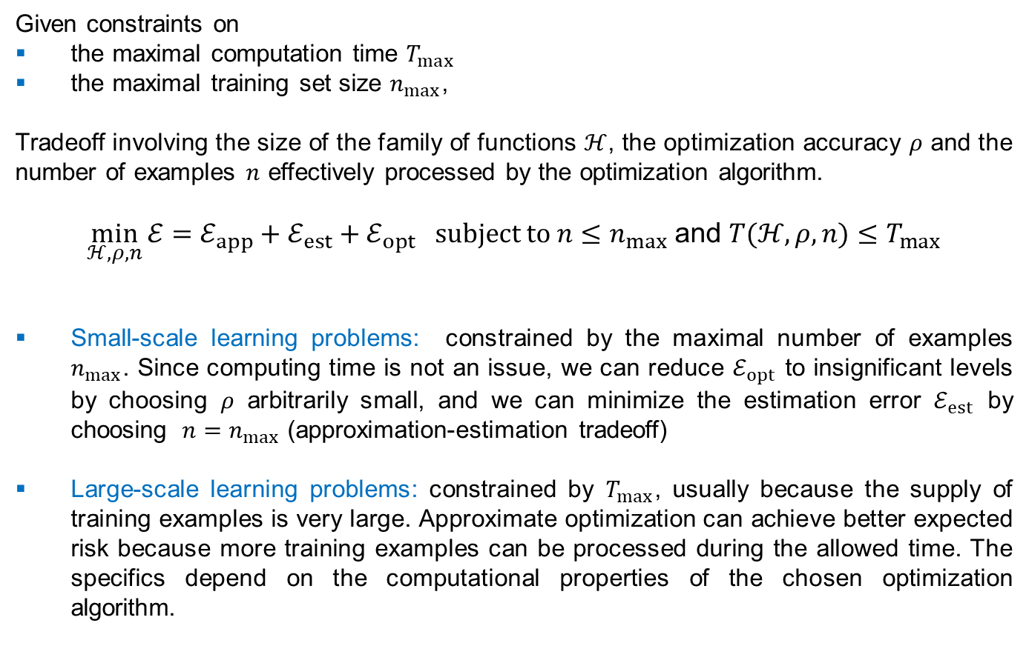
Empirical Risk Minimization
Given constraints on
the maximal computation time $T_{max}$
the maximal training set size $n_{max}$,
Tradeoff involving the size of the family of functions $ℋ$, the optimization accuracy $ρ$ and the number of examples $n$ effectively processed by the optimization algorithm.
$\min_{ℋ,ρ,n}{ℰ=ℰ_{app}+ℰ_{est}+ℰ_{opt} } subject to{ n≤n}_{max}$ and ${T(ℋ,ρ,n)≤T}_{max}$
Small-scale learning problems: constrained by the maximal number of examples $n_{max}$. Since computing time is not an issue, we can reduce $ℰ_{opt}$ to insignificant levels by choosing $ρ$ arbitrarily small, and we can minimize the estimation error $ℰ_{est}$ by choosing ${ n=n}_{max}$ (approximation-estimation tradeoff)
Large-scale learning problems: constrained by $T_{max}$, usually because the supply of training examples is very large. Approximate optimization can achieve better expected risk because more training examples can be processed during the allowed time. The specifics depend on the computational properties of the chosen optimization algorithm.

Slide 15
(Unconstrained) Optimization
Gradient Descent Methods

Slide 16
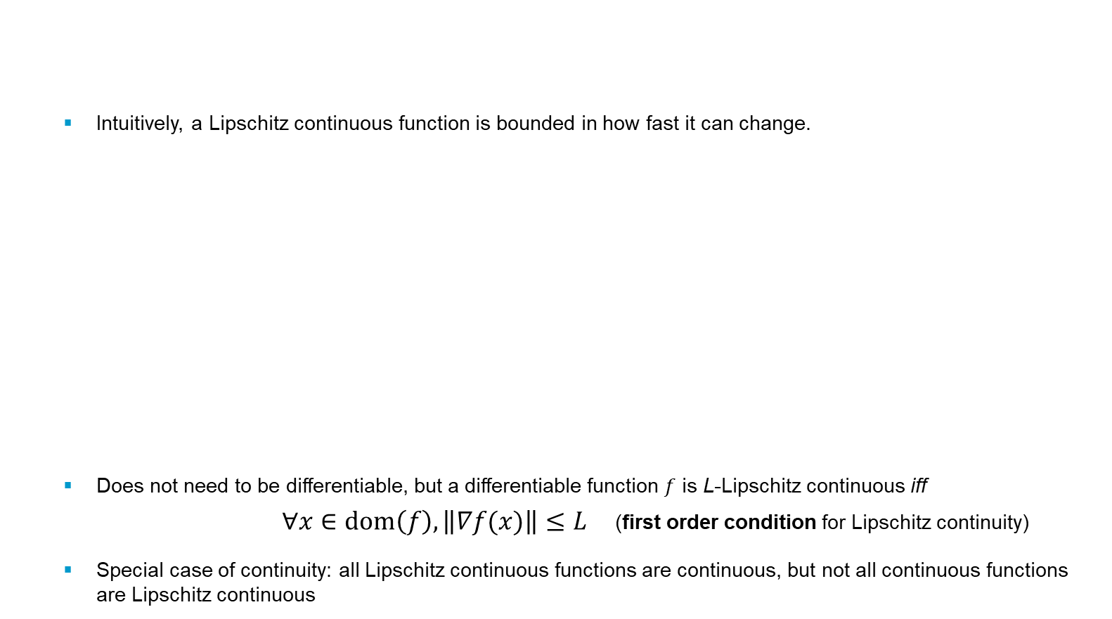
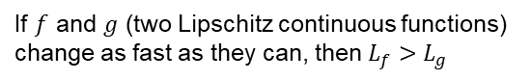
Lipschitz continuity
Intuitively, a Lipschitz continuous function is bounded in how fast it can change.
Does not need to be differentiable, but a differentiable function $f$ is L-Lipschitz continuous iff
$∀x∈dom\left(f\right), \left\|∇f(x)\right\|≤L$ (first order condition for Lipschitz continuity)
Special case of continuity: all Lipschitz continuous functions are continuous, but not all continuous functions are Lipschitz continuous
Let $L≥0.$ A real-valued function $f$ is $L$-Lipschitz continuous iff $∀x,y∈dom(f)$
$$\left|f\left(x\right)−f(y)\right|≤L\left\|x−y\right\|$$
If $f$ and $g$ (two Lipschitz continuous functions) change as fast as they can, then $L_{f}>L_{g}$
The value of L increases with λ. As λ increases, function gets closer to discontinuity (λ$→∞$, step function – not Lipschitz continuous for any L)
Notes:
Ajouter une photo d’un vieux telegraphe, puis un mobile satellitte ancienne generation…can someone find an even older wireless communication system (smoke)

Slide 17
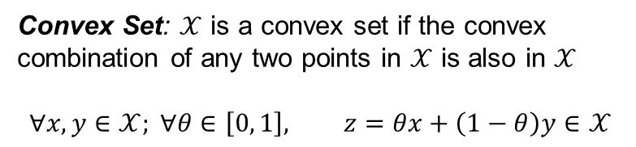
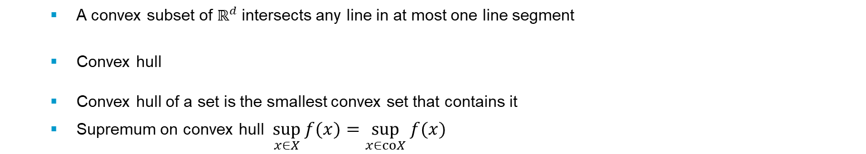
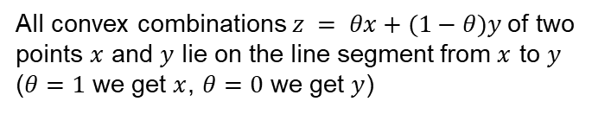
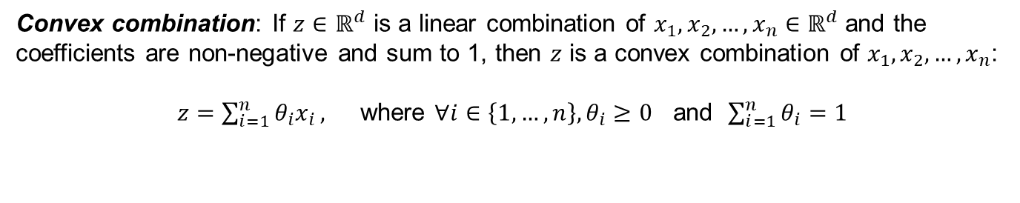
Convex Sets
Convex combination: If $z∈ℝ^{d}$ is a linear combination of $x_{1},x_{2},…,x_{n}∈ℝ^{d}$ and the coefficients are non-negative and sum to 1, then $z$ is a convex combination of $x_{1},x_{2},…,x_{n}$:
$z=\sum_{i=1}^{n}{θ_{i}x_{i}},$ where $∀i∈\left\{1,…,n\right\}, θ_{i}≥0$ and $\sum_{i=1}^{n}{θ_{i}=1}$
All convex combinations $z = θx+(1−θ)y$of two points $x$ and $y$ lie on the line segment from $x$ to $y$ ($θ=1$ we get $x$, $θ=0$ we get $y$)
Convex Set: $𝒳$ is a convex set if the convex combination of any two points in $𝒳$ is also in $𝒳$
$$∀x,y∈𝒳; ∀θ∈\left[0, 1\right], z=θx+\left(1−θ\right)y∈𝒳$$
A convex subset of $ℝ^{d}$intersects any line in at most one line segment
Convex hull
Convex hull of a set is the smallest convex set that contains it
Supremum on convex hull $\sup_{x∈X}{f(x)}=\sup_{x∈coX}{f(x)}$
Notes:
Ajouter une photo d’un vieux telegraphe, puis un mobile satellitte ancienne generation…can someone find an even older wireless communication system (smoke)

Slide 18
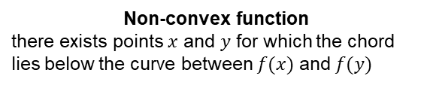
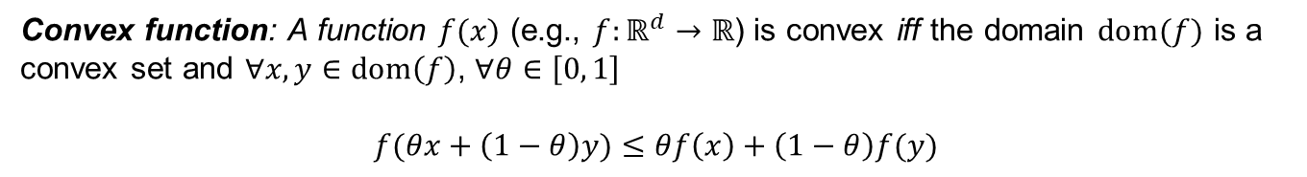
Convex Functions
Convex function: A function $f(x)$ (e.g., $f:ℝ^{d}→ℝ$) is convex iff the domain $dom(f)$ is a convex set and $∀x,y∈dom\left(f\right)$, $∀θ∈\left[0, 1\right]$
$f(θx+\left(1−θ\right)y)≤$ $θf\left(x\right)+\left(1−θ\right)f(y)$
Non-convex function
there exists points $x$ and $y$ for which the chord lies below the curve between $f(x)$ and $f(y)$
Convex function
the green chord lies above the function value
Convex functions are those whose epigraph is a convex set
epigraph: set of all points above the graph
Notes:
Ajouter une photo d’un vieux telegraphe, puis un mobile satellitte ancienne generation…can someone find an even older wireless communication system (smoke)

Slide 19
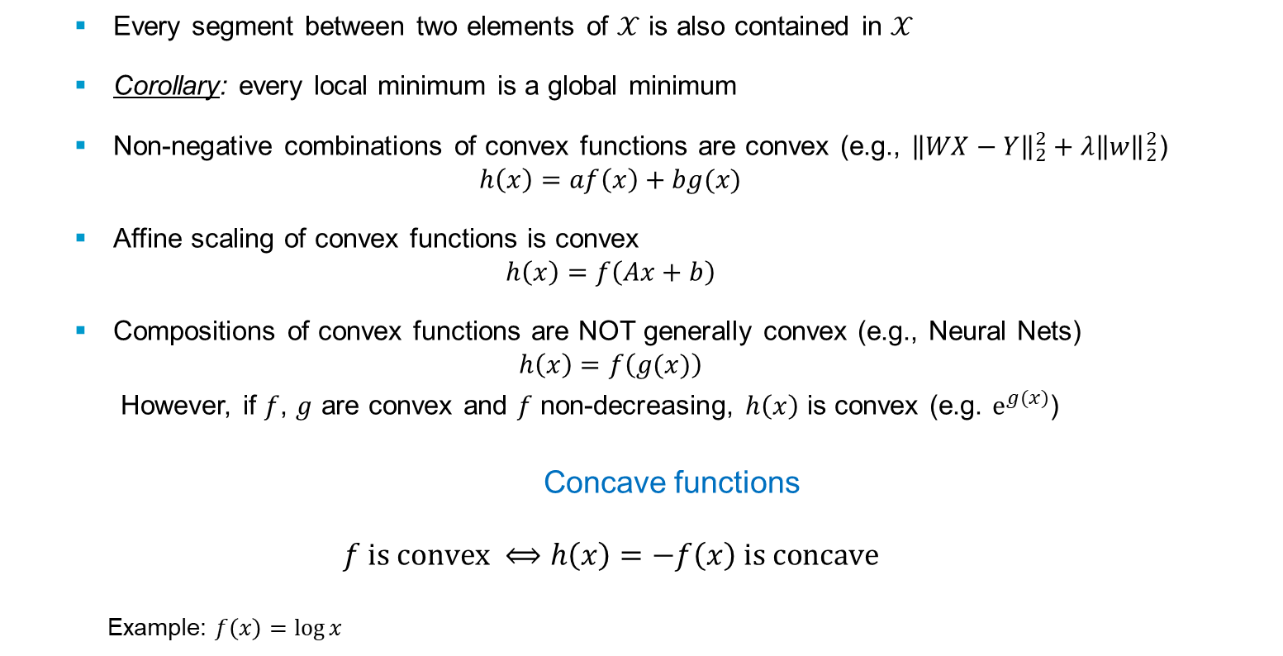
Convex Functions - Properties
Every segment between two elements of $𝒳$ is also contained in $𝒳$
Corollary: every local minimum is a global minimum
Non-negative combinations of convex functions are convex (e.g., ${\left\|WX−Y\right\|}_{2}^{2}+λ{\left\|w\right\|}_{2}^{2}$)
$$h\left(x\right)=af\left(x\right)+bg(x)$$
Affine scaling of convex functions is convex
$$h\left(x\right)=f\left(Ax+b\right)$$
Compositions of convex functions are NOT generally convex (e.g., Neural Nets)
$$h\left(x\right)=f\left(g(x)\right)$$
However, if $f$, $g$ are convex and $f$ non-decreasing, $h\left(x\right)$ is convex (e.g. $e^{g(x)}$)
Concave functions
$$f is convex ⟺h\left(x\right)=−f\left(x\right) is concave$$
Example: $f\left(x\right)=\log{x}$
$$f^{′′}\left(x\right)=−\frac{1}{x^{2}}≤0$$
Notes:
Ajouter une photo d’un vieux telegraphe, puis un mobile satellitte ancienne generation…can someone find an even older wireless communication system (smoke)

Slide 20
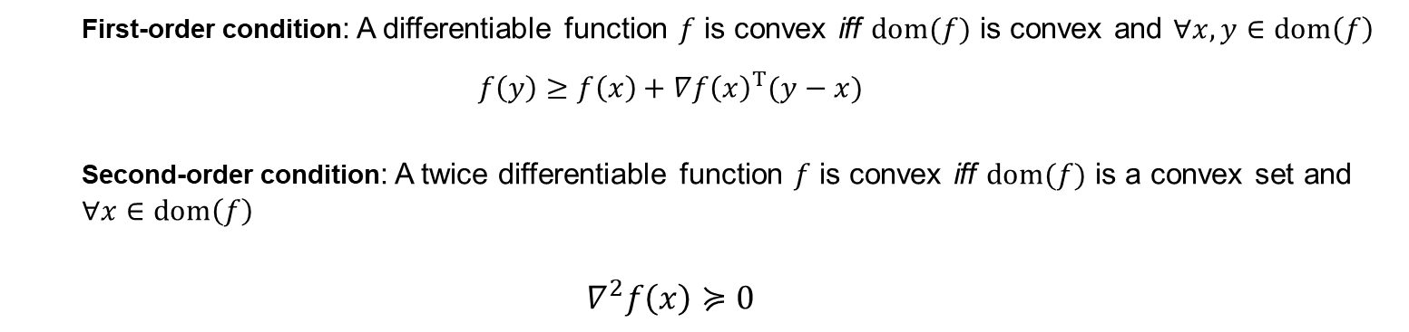
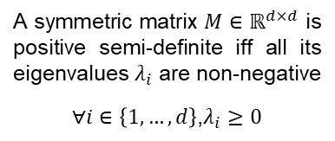
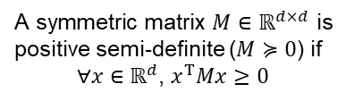
Convex Functions – Alternative Definitions
First-order condition: A differentiable function $f$ is convex iff $dom(f)$ is convex and $∀x,y∈dom\left(f\right)$
$$f\left(y\right)≥f\left(x\right)+∇{f\left(x\right)}^{T}(y−x)$$
Second-order condition: A twice differentiable function $f$ is convex iff $dom(f)$ is a convex set and $∀x∈dom\left(f\right)$
$$∇^{2}f\left(x\right)≽0$$
For a twice differentiable function to be convex, its Hessian must be positive semi-definite
In general, for any non-negative eigenvalue of the Hessian, the curvature of the function is non-negative along the corresponding eigenvector, thus the function is convex in that direction.
On the other hand, a non-positive eigenvalue represents non-positive curvature along the eigenvector, and the function is concave in that direction. So, for a function to be convex, it has to have non-negative curvature, thus non-negative eigenvalues, in all directions
A symmetric matrix $M∈ℝ^{d×d}$ is positive semi-definite ($M≽0$) if
$∀x∈$ $ℝ^{d}$, $x^{T}Mx≥0$
A symmetric matrix $M∈ℝ^{d×d}$ is positive semi-definite iff all its eigenvalues $λ_{i}$ are non-negative
$∀i∈\left\{1,…,d\right\}$,$λ_{i}≥0$
Notes:
Ajouter une photo d’un vieux telegraphe, puis un mobile satellitte ancienne generation…can someone find an even older wireless communication system (smoke)

Slide 21
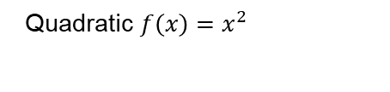
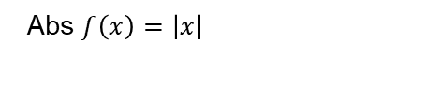
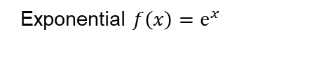
Convex Functions - Examples
Quadratic $f\left(x\right)=x^{2}$
$f(αx+\left(1−α\right)y)≤$ $αf\left(x\right)+\left(1−α\right)f(y)$
Abs $f\left(x\right)=\left|x\right|$
Exponential $f\left(x\right)=e^{x}$
Notes:
Ajouter une photo d’un vieux telegraphe, puis un mobile satellitte ancienne generation…can someone find an even older wireless communication system (smoke)

Slide 22
Smoothness
A (differentiable) function$f$ is said to be $L$-smooth if its gradients are Lipschitz continuous
$$\text{g}\text{(}\text{y}\text{)}$$
$$f(y)$$
$$x$$
$$f(y)$$
$$y$$
first order Taylor expansion g(y)
Notes:
Ajouter une photo d’un vieux telegraphe, puis un mobile satellitte ancienne generation…can someone find an even older wireless communication system (smoke)

Slide 23
Strongly Convex Functions
We can “strengthen” the notion of convexity by defining$μ$-strong convexity, that is
first order Taylor expansion
Equivalent second-order characterization (for twice differentiable functions)
A twice differentiable function $f$ is said to be $μ$-strongly convex and $L$-smooth if
Notes:
Ajouter une photo d’un vieux telegraphe, puis un mobile satellitte ancienne generation…can someone find an even older wireless communication system (smoke)

Slide 24
Strongly Convex and Smooth Functions
Main Inequality
If $∇f$ is $L$-Lipschitz continuous and $f$ is $μ$-strongly convex
Notes:
Ajouter une photo d’un vieux telegraphe, puis un mobile satellitte ancienne generation…can someone find an even older wireless communication system (smoke)

Slide 25
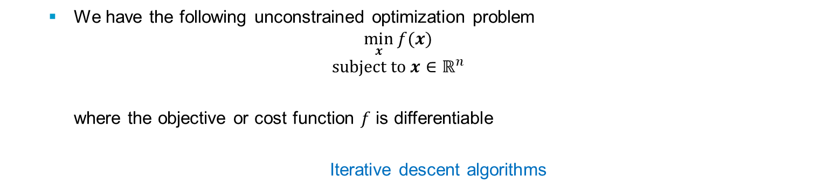
Gradient Methods
We have the following unconstrained optimization problem
$$\min_{x}{f(x)}$$
$$subject to x∈ℝ^{n}$$
where the objective or cost function $f$ is differentiable
Iterative descent algorithms
Notes:
Ajouter une photo d’un vieux telegraphe, puis un mobile satellitte ancienne generation…can someone find an even older wireless communication system (smoke)

Slide 26
Gradient Methods
We have the following unconstrained optimization problem
$$\min_{x}{f(x)}$$
$$subject to x∈ℝ^{n}$$
where the objective or cost function $f$ is differentiable
Iterative descent algorithms
Notes:
Ajouter une photo d’un vieux telegraphe, puis un mobile satellitte ancienne generation…can someone find an even older wireless communication system (smoke)

Slide 27
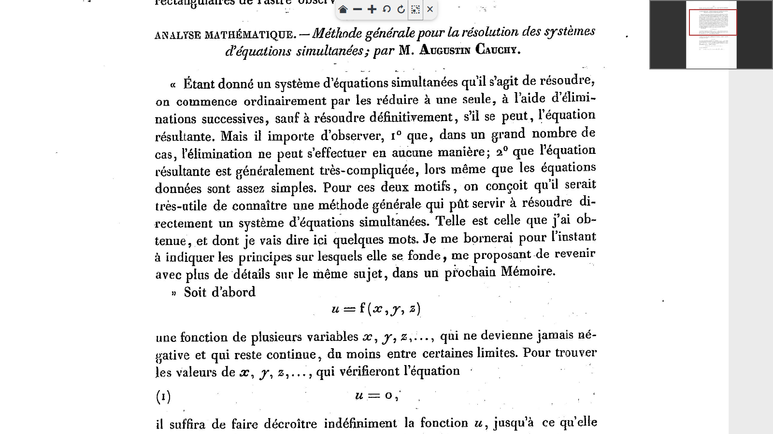
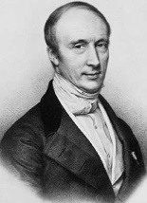
Gradient Descent
One of the most important examples:
Traced to Augustin Louis Cauchy (1857)
Also known as steepest descent
Notes:
Ajouter une photo d’un vieux telegraphe, puis un mobile satellitte ancienne generation…can someone find an even older wireless communication system (smoke)

Slide 28
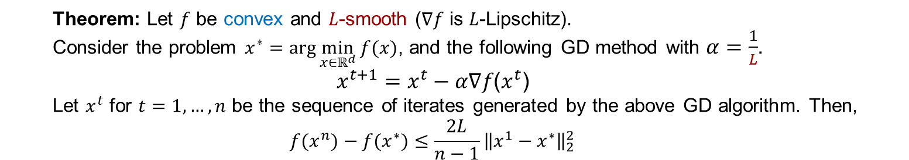
Convex and Smooth Functions
Theorem: Let $f$ be convex and $L$-smooth (∇𝑓 is 𝐿-Lipschitz).
Consider the problem $x^{∗}=arg\min_{x∈ℝ^{d}}{f(x)}$, and the following GD method with $α=\frac{1}{L}$.
$$x^{t+1}=x^{t}−α\text{∇}\text{f}\text{(}x^{t}\text{)}$$
Let $x^{t}$ for $t=1,…,n$ be the sequence of iterates generated by the above GD algorithm. Then,
$${f(x}^{n})−f(x^{∗})≤\frac{2L}{n−1}{\left\|x^{1}−x^{∗}\right\|}_{2}^{2}$$
Proof
Let $f$ be convex and $L$-smooth. It follows that
Co-coercivity
Notes:
Ajouter une photo d’un vieux telegraphe, puis un mobile satellitte ancienne generation…can someone find an even older wireless communication system (smoke)

Slide 29
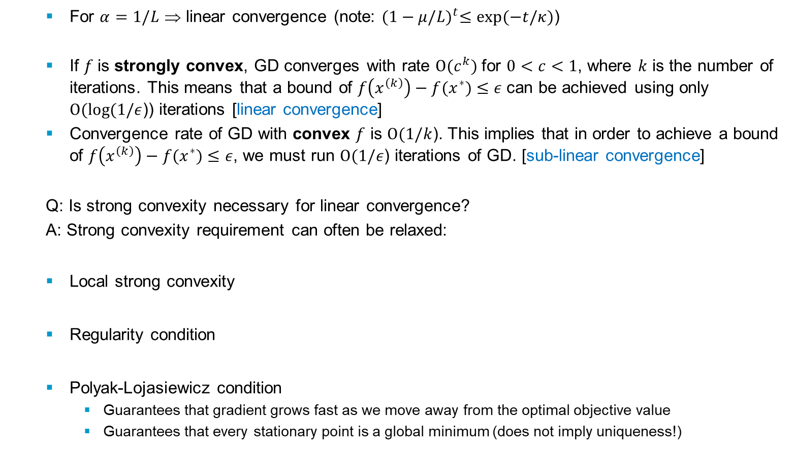
GD Convergence Rates
For $α=1/L$ ⇒ linear convergence (note: ${(1−μ/L)}^{t}≤exp⁡(−t/κ)$)
If $f$is strongly convex, GD converges with rate $O(c^{k})$for $0<c<1$, where $k$ is the number of iterations. This means that a bound of $f\left(x^{\left(k\right)}\right)−f(x^{∗})≤ε$can be achieved using only $O(\log{(1/ε}$)) iterations [linear convergence]
Convergence rate of GD with convex $f$ is $O(1/k$). This implies that in order to achieve a bound of $f\left(x^{\left(k\right)}\right)−f(x^{∗})≤ε$, we must run $O(1/ε$) iterations of GD. [sub-linear convergence]
Q: Is strong convexity necessary for linear convergence?
A: Strong convexity requirement can often be relaxed:
Local strong convexity
Regularity condition
Polyak-Lojasiewicz condition
Guarantees that gradient grows fast as we move away from the optimal objective value
Guarantees that every stationary point is a global minimum (does not imply uniqueness!)
Notes:
Ajouter une photo d’un vieux telegraphe, puis un mobile satellitte ancienne generation…can someone find an even older wireless communication system (smoke)

Slide 30
Gradient Descent & Large Scale Optimization
Most ML problems can be written as an optimization problem
Computing the gradient takes $O(n)$ time
GD with More Data (e.g. add an extra copy of every examples in the training set)
Same objective function
But gradients take 2x the time to compute
How to scale up to large datasets???
Notes:
Ajouter une photo d’un vieux telegraphe, puis un mobile satellitte ancienne generation…can someone find an even older wireless communication system (smoke)

Slide 31
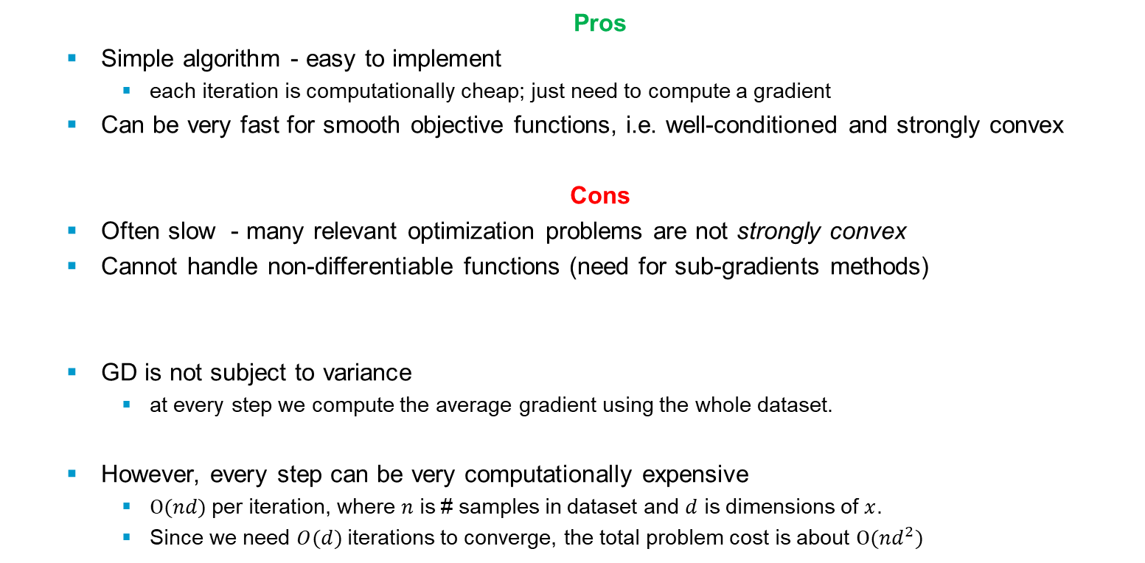
Gradient Descent in a Nutshell
Pros
Simple algorithm - easy to implement
each iteration is computationally cheap; just need to compute a gradient
Can be very fast for smooth objective functions, i.e. well-conditioned and strongly convex
Cons
Often slow - many relevant optimization problems are not strongly convex
Cannot handle non-differentiable functions (need for sub-gradients methods)
GD is not subject to variance
at every step we compute the average gradient using the whole dataset.
However, every step can be very computationally expensive
$O(nd)$per iteration, where $n$ is # samples in dataset and $d$ is dimensions of $x$.
Since we need $O(d)$iterations to converge, the total problem cost is about $O(nd^{2})$
Notes:
Ajouter une photo d’un vieux telegraphe, puis un mobile satellitte ancienne generation…can someone find an even older wireless communication system (smoke)

Slide 32
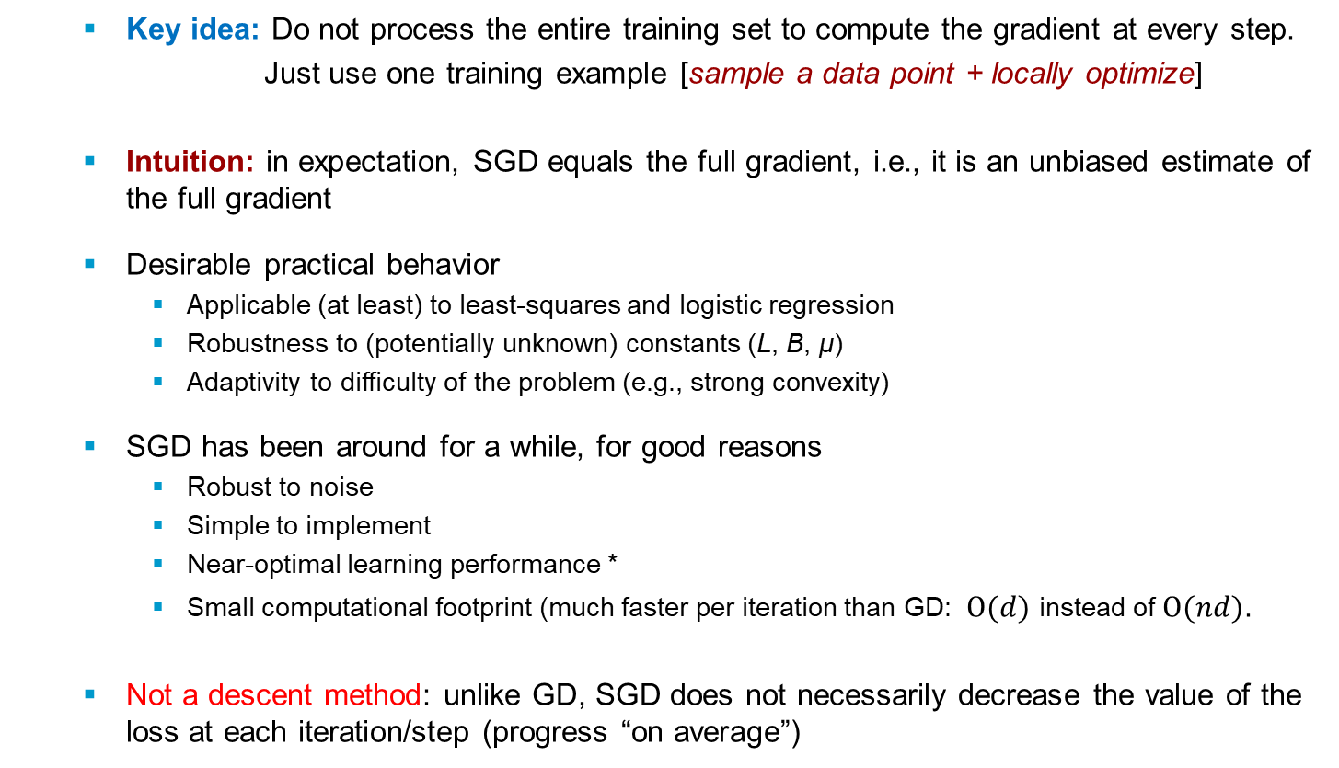

Stochastic Gradient Descent
Key idea: Do not process the entire training set to compute the gradient at every step.
Just use one training example [sample a data point + locally optimize]
Intuition: in expectation, SGD equals the full gradient, i.e., it is an unbiased estimate of the full gradient
Desirable practical behavior
Applicable (at least) to least-squares and logistic regression
Robustness to (potentially unknown) constants (L, B, μ)
Adaptivity to difficulty of the problem (e.g., strong convexity)
SGD has been around for a while, for good reasons
Robust to noise
Simple to implement
Near-optimal learning performance *
Small computational footprint (much faster per iteration than GD: $O(d)$ instead of $O(nd)$.
Not a descent method: unlike GD, SGD does not necessarily decrease the value of the loss at each iteration/step (progress “on average”)
$f$ B-Lipschitz continuous
$f$ μ-strongly convex
$f^{′}$ L-Lipschitz continuous
Notes:
Ajouter une photo d’un vieux telegraphe, puis un mobile satellitte ancienne generation…can someone find an even older wireless communication system (smoke)

Slide 33
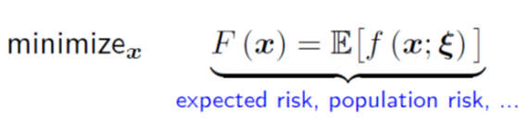
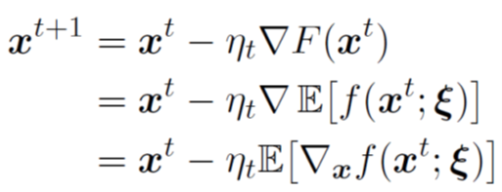
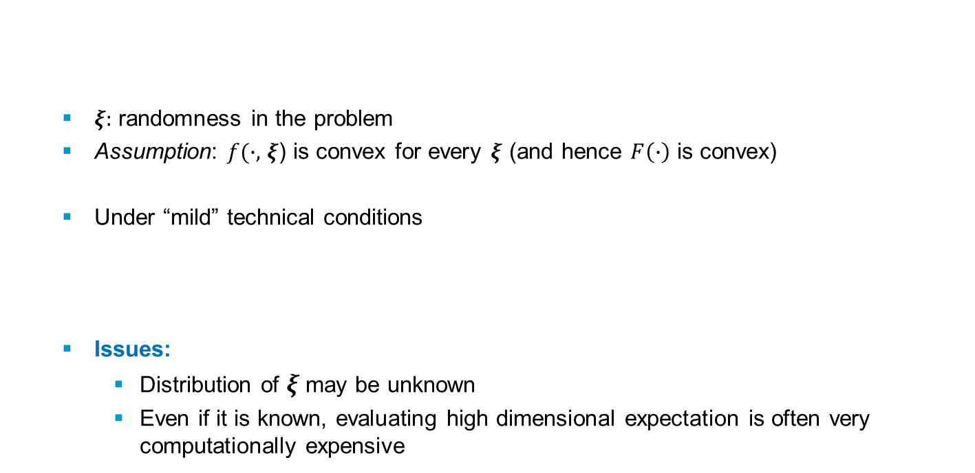
Stochastic Programming
$ξ:$ randomness in the problem
Assumption: $f(∙,$ $ξ$) is convex for every $ξ$ (and hence $F\left(∙\right)$ is convex)
Under “mild” technical conditions
Issues:
Distribution of $ξ$may be unknown
Even if it is known, evaluating high dimensional expectation is often very computationally expensive
Notes:
Ajouter une photo d’un vieux telegraphe, puis un mobile satellitte ancienne generation…can someone find an even older wireless communication system (smoke)

Slide 34
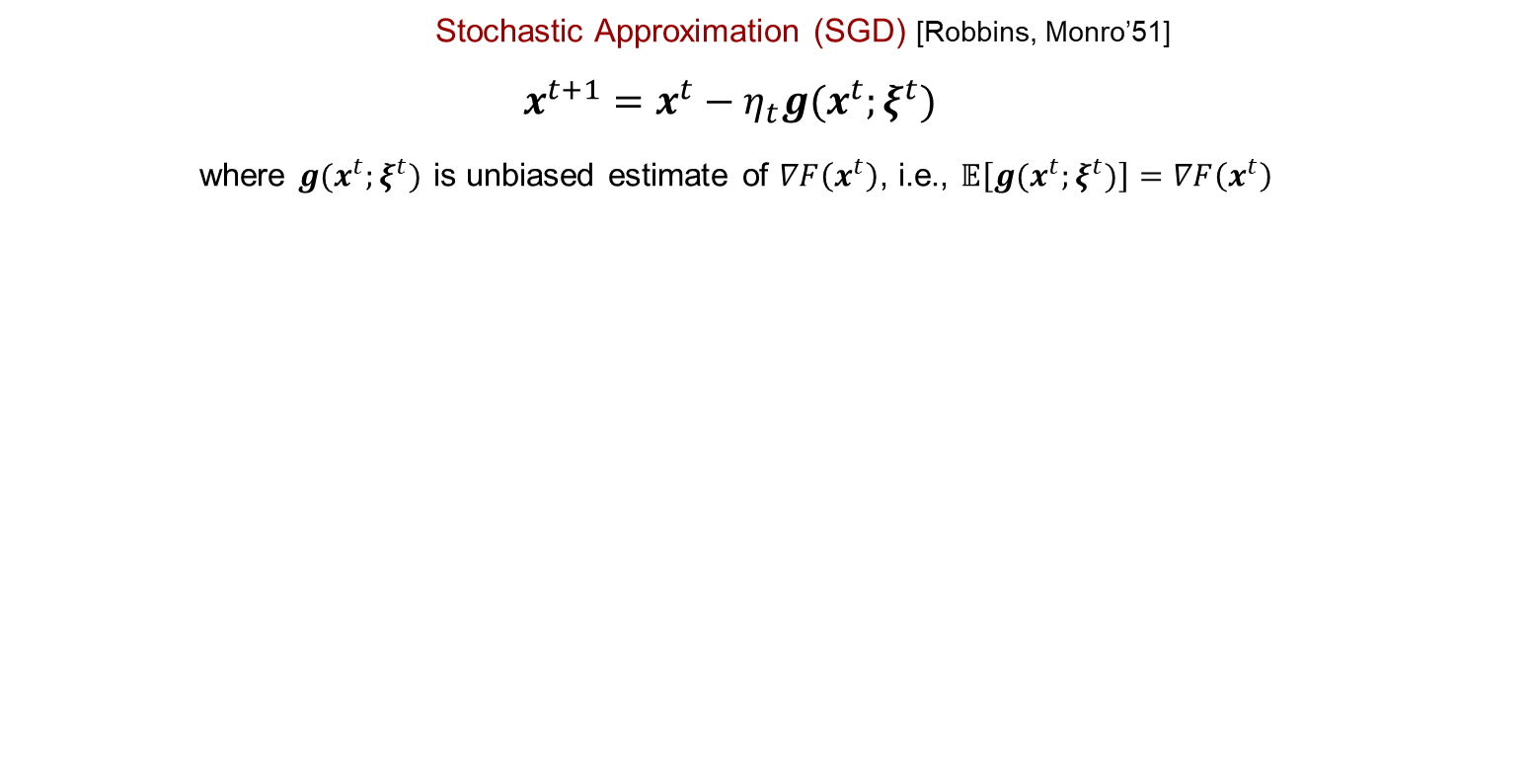
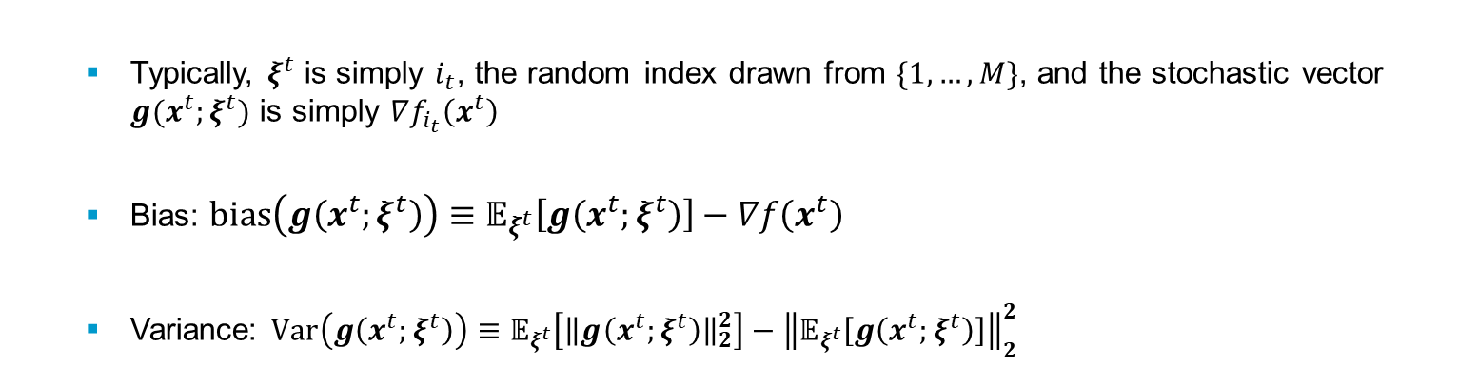
Stochastic Gradient Descent
Stochastic Approximation (SGD) [Robbins, Monro’51]
$$x^{t+1}=x^{t}−η_{t}g(x^{t};ξ^{t})$$
where $g(x^{t};ξ^{t})$ is unbiased estimate of $∇F\left(x^{t}\right)$, i.e., $𝔼\left[g(x^{t};ξ^{t})\right]=∇F\left(x^{t}\right)$
Typically, $ξ^{t}$ is simply $i_{t}$, the random index drawn from $\{1,…,M\}$, and the stochastic vector $g(x^{t};ξ^{t})$ is simply $∇f_{i_{t}}\left(x^{t}\right)$
Bias: $bias\left(g\left(x^{t};ξ^{t}\right)\right)≡𝔼_{ξ^{t}}\left[g\left(x^{t};ξ^{t}\right)\right]−∇f\left(x^{t}\right)$
Variance: $Var\left(g\left(x^{t};ξ^{t}\right)\right)≡𝔼_{ξ^{t}}\left[{\left\|g\left(x^{t};ξ^{t}\right)\right\|}_{2}^{2}\right]−{\left\|𝔼_{ξ^{t}}\left[g\left(x^{t};ξ^{t}\right)\right]\right\|}_{2}^{2}$
Notes:
Ajouter une photo d’un vieux telegraphe, puis un mobile satellitte ancienne generation…can someone find an even older wireless communication system (smoke)

Slide 35
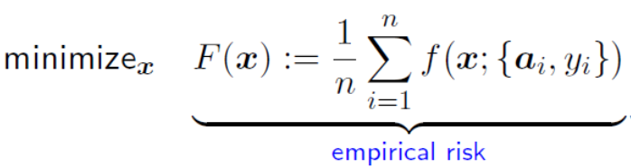
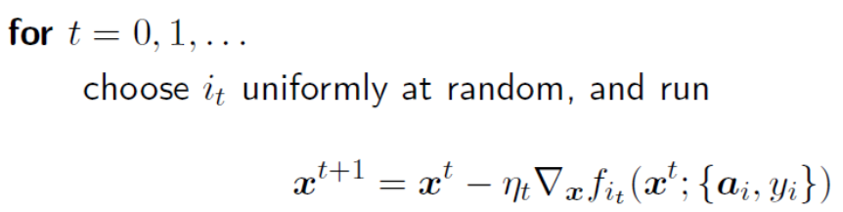
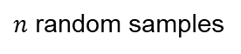
SGD for Empirical Risk Minimization
Benefits: SGD exploits information more efficiently than batch methods
Real-world data usually involves lots of redundancy; using all data simultaneously in each iteration might be inefficient
SGD is particularly efficient at the very beginning, as it achieves fast initial improvement with very low per-iteration cost
$n$ random samples
e.g., quadratic loss
Notes:
Ajouter une photo d’un vieux telegraphe, puis un mobile satellitte ancienne generation…can someone find an even older wireless communication system (smoke)

Slide 36
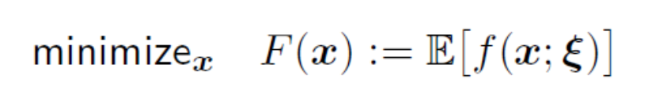
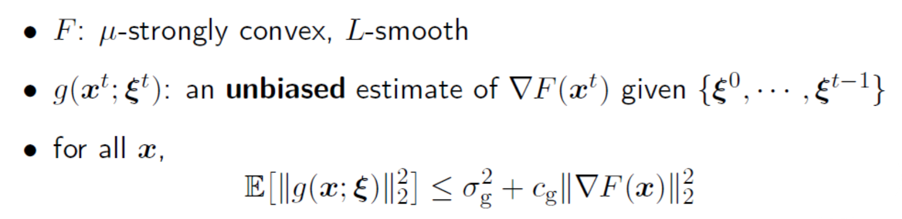


Convergence – Fixed stepsizes
Fixed stepsizes: If$η_{t}≡η≤\frac{1}{Lc_{g}}$, then SGD achieves
Fast (linear) convergence at the very beginning
Converges to some neighborhood of $x^{∗} −$ variation in gradient computation prevents further progress
For noiseless gradient computation (i.e.,$σ_{g}^{2}=0$), it converges linearly to optimal points
Smaller stepsizes $η$yield better converging points
Gradient “Variance”
(bound on the 2nd moment)
$$c_{g}≥μ^{2}>0$$
$$∇{F(x)}^{T}𝔼_{ξ}\left[g\left(x;ξ\right)\right]≥μ{\left\|∇F(x)\right\|}_{2}^{2}$$
$$𝔼\left[F\left(x^{t}\right)−F\left(x^{∗}\right)\right]≤\frac{ηLσ_{g}^{2}}{2μ}+{(1−ημ)}^{t}\left(F\left(x^{0}\right)−F\left(x^{∗}\right)\right)\underset{→}{t→∞} \frac{ηLσ_{g}^{2}}{2μ}$$
Notes:
Ajouter une photo d’un vieux telegraphe, puis un mobile satellitte ancienne generation…can someone find an even older wireless communication system (smoke)

Slide 37


One practical strategy
Run SGD with fixed stepsize
Intuition: SGD (with fixed stepsize) converges to a noise ball (iterates are randomly jumping around some space surrounding the optimum).
$𝔼\left[{\left\|x^{t}−x^{∗}\right\|}^{2}\right]≤{\left(1−ημ\right)}^{t}{\left\|x^{0}−x^{∗}\right\|}^{2}+\frac{ησ^{2}}{μ}$ (bounded gradient “variance” $𝔼\left[{\left\|∇f_{t} (x)\right\|}^{2}\right]≤σ^{2}$)
Whenever progress stalls, reduce the stepsizes (e.g., half) and continue
Bottou, Curtis, Nocedal, Optimization methods for large-scale machine learning, SIAM Review, 2018
Notes:
Ajouter une photo d’un vieux telegraphe, puis un mobile satellitte ancienne generation…can someone find an even older wireless communication system (smoke)

Slide 38

Convergence – Diminishing stepsizes
Diminishing stepsizes: If$η_{t}=\frac{β}{γ+t}$ for some $β>\frac{1}{cμ}$, and $γ>0$, such that $η_{1}≤\frac{μ}{Lc_{g}}$ then
where $ν=max\left\{\frac{β^{2}Lσ_{g}^{2}}{2\left(βcμ−1\right)},(γ+1)(F\left(x^{1}\right)−F\left(x^{∗}\right))\right\}$
Convergence rate $O(1/t)$ with decreasing stepsize $η_{t}≍\frac{1}{t}$
SGD with stepsizes $η_{t}≍\frac{1}{t}$ is optimal!
Sufficient conditions for convergence:
$\sum_{t=1}^{∞}{{η_{t}}^{2}}<∞$ $\sum_{t=1}^{∞}{η_{t}=∞}$
Role of the Initial Point:
Fixed stepsize: the initial gap $\left\|{F(x}^{0})−{F(x}^{∗})\right\|$ appears with an exponentially decreasing factor
Diminishing stepsizes: gap appears prominently in the second term defining $ν$
In practice, the initial stepsize should be chosen as large as allowed, i.e., $η_{t}=μ/(Lc_{g})$.
$$𝔼\left[F\left(x^{t}\right)−F\left(x^{∗}\right)\right]≤\frac{ν}{γ+t}$$
Notes:
Ajouter une photo d’un vieux telegraphe, puis un mobile satellitte ancienne generation…can someone find an even older wireless communication system (smoke)

Slide 39

GD vs. SGD in a Nutshell
Convergence rates
Full (batch) GD: For convex $f$, with $L$-Lipschitz gradient, under suitable stepsizes:
$$f(x^{t}) − f(x^{∗}) = O(1/t)$$
SGD: For convex $f$, under diminishing stepsizes (along with other conditions):
$$𝔼[f\left(x^{t}\right)] − f(x^{∗}) = O(1/\sqrt{t})$$
(Here $t$ can be a full iteration or a batch)
Convergence rates (strong convexity)
Under strong convexity assumptions on $f$ (with parameter $μ$)
Full GD: For strongly convex $f$, with $L$-Lipschitz gradient, for suitable stepsizes GD has a linear rate:
$$f\left(x^{t}\right)− f\left(x^{∗}\right)= O\left(ρ^{t}\right) where ρ<1$$
SGD: under strong convexity (plus other assumptions as before), SG sequence has sublinear rate:
$$𝔼[f\left(x^{t}\right)] − f(x^{∗}) = O(1/t)$$
Can we do better than sublinear convergence for the SG method?
Notes:
Ajouter une photo d’un vieux telegraphe, puis un mobile satellitte ancienne generation…can someone find an even older wireless communication system (smoke)

Slide 40

SGD - Remarks
Convergence rates are not great, but the complexity per iteration is small (1 gradient evaluation for minimizing an empirical risk vs. n for the full batch algorithm)
When the amount of data is infinite, the method minimizes the expected risk (which is what we want)
Choosing a good learning rate automatically is an open problem
The Hidden Cost of SGD
By switching to SGD, we eliminated the costly sum over the dataset
$x^{t+1}=x^{t}−η_{t}\frac{1}{n}\sum_{i=1}^{n}{∇f(x^{t},ξ_{i})}$ $x^{t+1}=x^{t}−η_{t}∇f(x^{t},ξ_{i_{t}})$
But the cost of computing the individual gradients remains
The capabilities of ML methods are limited by the computing time rather than the sample size
This is where SGD performs very well
So, use SGD when training time is the bottleneck.
Notes:
Ajouter une photo d’un vieux telegraphe, puis un mobile satellitte ancienne generation…can someone find an even older wireless communication system (smoke)

Slide 41

Minibatch Gradient Descent
GD: all examples at once $x^{t+1}=x^{t}−η_{t}\frac{1}{n}\sum_{i=1}^{n}{∇f(x^{t};ξ_{i})}$
SGD: one example at a time $x^{t+1}=x^{t}−η_{t}∇f(x^{t};ξ_{i_{t}})$
Is it really all or nothing? What about an intermediate approach?
Minibatch GD: calculate gradients over a subset of training points instead of just one
$$x^{t+1}=x^{t}−η_{t}\frac{1}{\left|B_{t}\right|}\sum_{i∈B_{t}}^{n}{∇f(x^{t};ξ_{i})}$$
where $B_{t}$ is sampled uniformly from the set of all subsets of $\left\{1, …, n\right\}$ of size $b$.
The parameter $b$ is the batch size (typically $b≪n)$
Not a descent method, but “closer” to one
Less time to compute each update than GD (only needs to sum up $b$ gradients, rather than $n$)
But iterations more expensive than SGD
What’s the benefit? Maybe it converges faster than SGD? (converges to a smaller noise ball)
Notes:
Ajouter une photo d’un vieux telegraphe, puis un mobile satellitte ancienne generation…can someone find an even older wireless communication system (smoke)

Slide 42

Minibatch Gradient Descent
Effect of minibatch size on convergence rate, throughput, and end-to-end training time of a ResNet56 CIFAR10 model.
A larger minibatch size gives better throughput (images processing per unit time), but lower final validation accuracy!
https://dawn.cs.stanford.edu/benchmark/index.html
Notes:
Ajouter une photo d’un vieux telegraphe, puis un mobile satellitte ancienne generation…can someone find an even older wireless communication system (smoke)

Slide 43



GD vs. SGD vs. Minibatch GD
Image credit: A.L. Chandra / Ethan Irby
Notes:
Ajouter une photo d’un vieux telegraphe, puis un mobile satellitte ancienne generation…can someone find an even older wireless communication system (smoke)

Slide 44
Problems with SGD
What if loss changes quickly in one direction and slowly in another?
What does gradient descent do?
Very slow progress along shallow dimension, jitter along steep direction
Poor conditioning: loss function has high condition number, i.e., ratio of largest to smallest singular value of the Hessian matrix is large
$$x_{2}$$
$$x_{1}$$
Notes:
Ajouter une photo d’un vieux telegraphe, puis un mobile satellitte ancienne generation…can someone find an even older wireless communication system (smoke)

Slide 45




Problems with SGD (cont’d)
What if the loss function has a local minima or saddle point?
Zero gradient, gradient descent gets stuck
Saddle point: minima in one direction ($x$) and local maxima in another direction ($y$). If the contour is flatter towards the $x$ direction, (S)GD would keep oscillating in the $y$ direction (illusion we have converged to a minima).
Saddle points much more common in high dimensions
Saddle point
Noisy gradients: common in practice (mini-batches used)
Notes:
Ajouter une photo d’un vieux telegraphe, puis un mobile satellitte ancienne generation…can someone find an even older wireless communication system (smoke)

Slide 46
Improving SGD
Diminishing stepsizes (learning rates) are needed due to the variability of stochastic gradients.
Can we reduce the variability of those stochastic gradients and use a constant learning rate?
Can we use better learning rate schedules to accelerate SG method?
Noise reduction Methods
Reduce the errors in the gradient estimates and/or iterate sequence
Dynamic sampling: gradually increase the minibatch size used in the gradient computation, thus employing increasingly more accurate gradient estimates as the optimization process proceeds.
Gradient aggregation: improve the quality of the search directions by storing gradient estimates corresponding to samples employed in previous iterations, updating one (or some) of these estimates in each iteration, and defining the search direction as a weighted average of these estimates.
Iterative averaging: instead of averaging gradient estimates, maintain an average of iterates computed during the optimization process.
Notes:
Ajouter une photo d’un vieux telegraphe, puis un mobile satellitte ancienne generation…can someone find an even older wireless communication system (smoke)

Slide 47





Gradient Methods with Momentum
Each step is chosen as a combination of the steepest descent direction and the most recent iterate displacement.
$$x_{t+1}=x_{t}−η_{t}∇F\left(x_{t}\right)+β_{t}(x_{t}−x_{t−1})$$
scalar sequences ${\{η}_{t}\}$ and$\{β_{t}\}$ are either predetermined or set dynamically
SGD
$$x_{t}=x_{t−1}−η∇f(x_{t−1})$$
SGD + Momentum
Effect of gradient is to increment the previous velocity. The velocity also decays by $ρ$
$$v_{t}={ρv}_{t−1}−η∇f(x_{t−1})$$
$$x_{t}=x_{t−1}+v_{t}$$
$${Δx}_{t}={ρv}_{t−1}−η∇f(x_{t−1})$$
$$={ρΔx}_{t−1}−η∇f(x_{t−1})$$
$ρ$ gives “friction”; typically $ρ$ = 0.9 or 0.99
Weight change is equal to the current velocity.
Weight change can be expressed in terms of the previous weight change and the current gradient.
www.willamette.edu/~gorr/classes/cs449/momrate.html
Notes:
Ajouter une photo d’un vieux telegraphe, puis un mobile satellitte ancienne generation…can someone find an even older wireless communication system (smoke)

Slide 48
A better type of Momentum (Nesterov)
The standard momentum method first computes the gradient at the current location and then takes a big jump in the direction of the updated accumulated gradient.
Nesterov momentum
First make a big jump in the direction of the previous accumulated gradient.
Then measure the gradient where you end up and make a correction.
It’s better to correct a mistake after you have made it!
Nesterov, “A method of solving a convex programming problem with convergence rate O(1/k²)”, 1983
I. Sutskever et al, “On the importance of initialization and momentum in deep learning”, ICML 2013
Notes:
Ajouter une photo d’un vieux telegraphe, puis un mobile satellitte ancienne generation…can someone find an even older wireless communication system (smoke)

Slide 49
A better type of Momentum (Nesterov)(cont’d)
SGD + Momentum
Nesterov Momentum
Notes:
Ajouter une photo d’un vieux telegraphe, puis un mobile satellitte ancienne generation…can someone find an even older wireless communication system (smoke)

Slide 50



Nesterov Momentum
$$v_{t}={ρv}_{t−1}−η∇f(x_{t−1}+{ρv}_{t−1})$$
$$x_{t}=x_{t−1}+v_{t}$$
usually, we want update in terms of $x_{t−1}, ∇f(x_{t−1})$
Change of variables ${\tilde{x}}_{t−1}=x_{t−1}+{ρv}_{t−1}$ and rearrange:
$$v_{t}={ρv}_{t−1}−η∇f({\tilde{x}}_{t−1})$$
$${\tilde{x}}_{t}={\tilde{x}}_{t−1}−{ρv}_{t−1}+\left(1+ρ\right)v_{t}$$
$={\tilde{x}}_{t−1}+v_{t}+ρ(v_{t}−v_{t−1})$
Notes:
Ajouter une photo d’un vieux telegraphe, puis un mobile satellitte ancienne generation…can someone find an even older wireless communication system (smoke)

Slide 51



AdaGrad
In a Nutshell: use history of sampled gradients to adapt the step size for the next SGD step to be inversely proportional to the usual magnitude of gradient steps in that direction.
Key idea: “learn slowly” from frequent features but “pay attention” to rare but informative feature
Define per-feature learning rate for feature $j$as
$$η_{t,j}=\frac{η}{\sqrt{G_{t,j}}} G_{t,j}=\sum_{i=1}^{t}{g_{k,j}^{2}}$$
$$x^{t+1}=x^{t}−\frac{η}{ζ+\sqrt{G_{t}}} ⨀{ g}^{t}$$
Frequently occurring features in the gradients get smaller updates (low learning rates); rare/infrequent features get higher learning rates
Well suited for dealing with sparse data
No need to manually tune the learning rate (default value 0.01).
$G_{t,j}$ keeps growing during training ⇒ learning rate shrinks and may become infinitesimally small, at which point the algorithm is no longer able to acquire additional knowledge.
$G_{t}∈ℝ^{d×d}$diagonal matrix where each diagonal element $(j,j)$ is the sum of squares of gradients of feature $j$ up to time step $t$
$⨀$matrix-vector product
$ζ>0$: smoothing constant to prevent
division by 0 (order of ${10}^{−8})$
Notes:
Ajouter une photo d’un vieux telegraphe, puis un mobile satellitte ancienne generation…can someone find an even older wireless communication system (smoke)

Slide 52



Gradient-based Optimization Methods
RMS Prop: use a moving average of squared gradients to normalize the gradient.
This normalization balances the step size (momentum), decreasing the step for large gradients to avoid exploding, and increasing the step for small gradients to avoid vanishing.
RMSprop uses an adaptive learning rate instead of treating the learning rate as a hyperparameter. This means that the learning rate changes over time.
Adam: it is basically RMS Prop + Momentum - default choice in practice!
Many other methods: AdaDelta, AdaMax, Nadam, AMSGrad, AdamW, QHAdam, AggMo,…
Learning rate decay over time
Notes:
Ajouter une photo d’un vieux telegraphe, puis un mobile satellitte ancienne generation…can someone find an even older wireless communication system (smoke)

Slide 53

Comparing Gradient-based Optimization Methods
Global minimum
Local minimum
Animation of 5 gradient descent methods on a surface:
GD (cyan), Momentum (magenta), AdaGrad (white), RMSProp (green), Adam (blue)
Credit: Lili Jiang
Notes:
Ajouter une photo d’un vieux telegraphe, puis un mobile satellitte ancienne generation…can someone find an even older wireless communication system (smoke)

Slide 54


Learning process dynamics
Contours of a loss surface and time evolution of different optimization algorithms.
Adagrad, Adadelta, and RMSprop almost immediately head off in the right direction and converge similarly fast,
Momentum and NAG are led off-track and make optimization look like a ball rolling down the hill (overshooting).
Visualization of a saddle point, where the curvature along different dimensions has different signs.
SGD, Momentum, and NAG have a very hard time breaking symmetry (SGD gets stuck on the top).
Adagrad, RMSprop, and Adadelta quickly head down the negative slope.
Credit: Alec Radford.& cs231n
Notes:
Ajouter une photo d’un vieux telegraphe, puis un mobile satellitte ancienne generation…can someone find an even older wireless communication system (smoke)

